Slide 1
Foundation of Computer science
By : Mohamed Agami

Slide 2
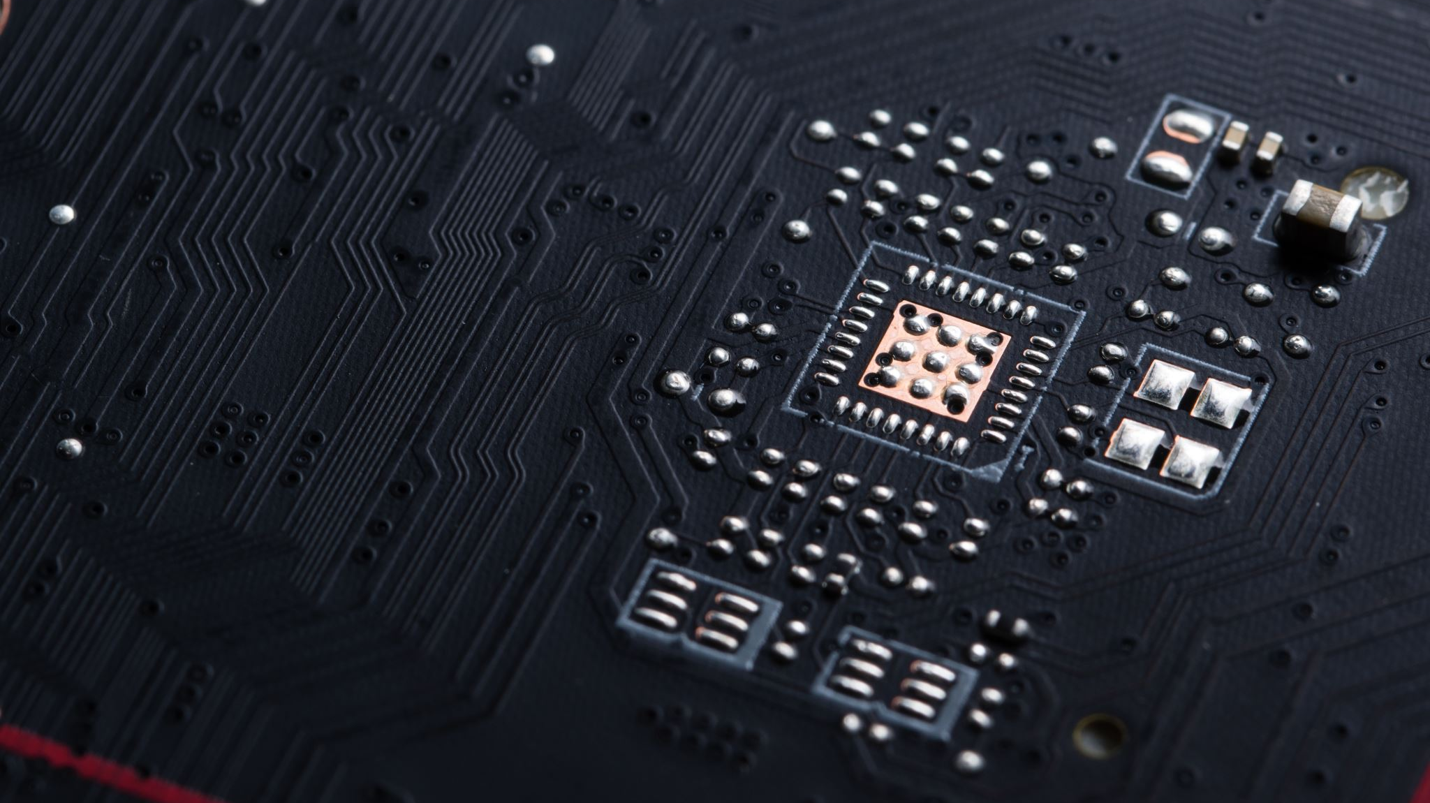
Lecture 11
Cpu part 2

Slide 3
CPU Feature

Slide 4
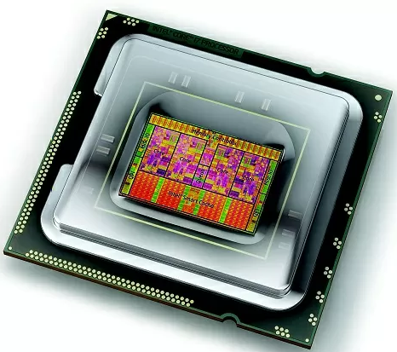
Processor speed
Integration Graphic
Socket and Chipset
Virilization
Processors architecture
The memory Feature
Multiprocessing Avidities
Cache memory
Security

Slide 5
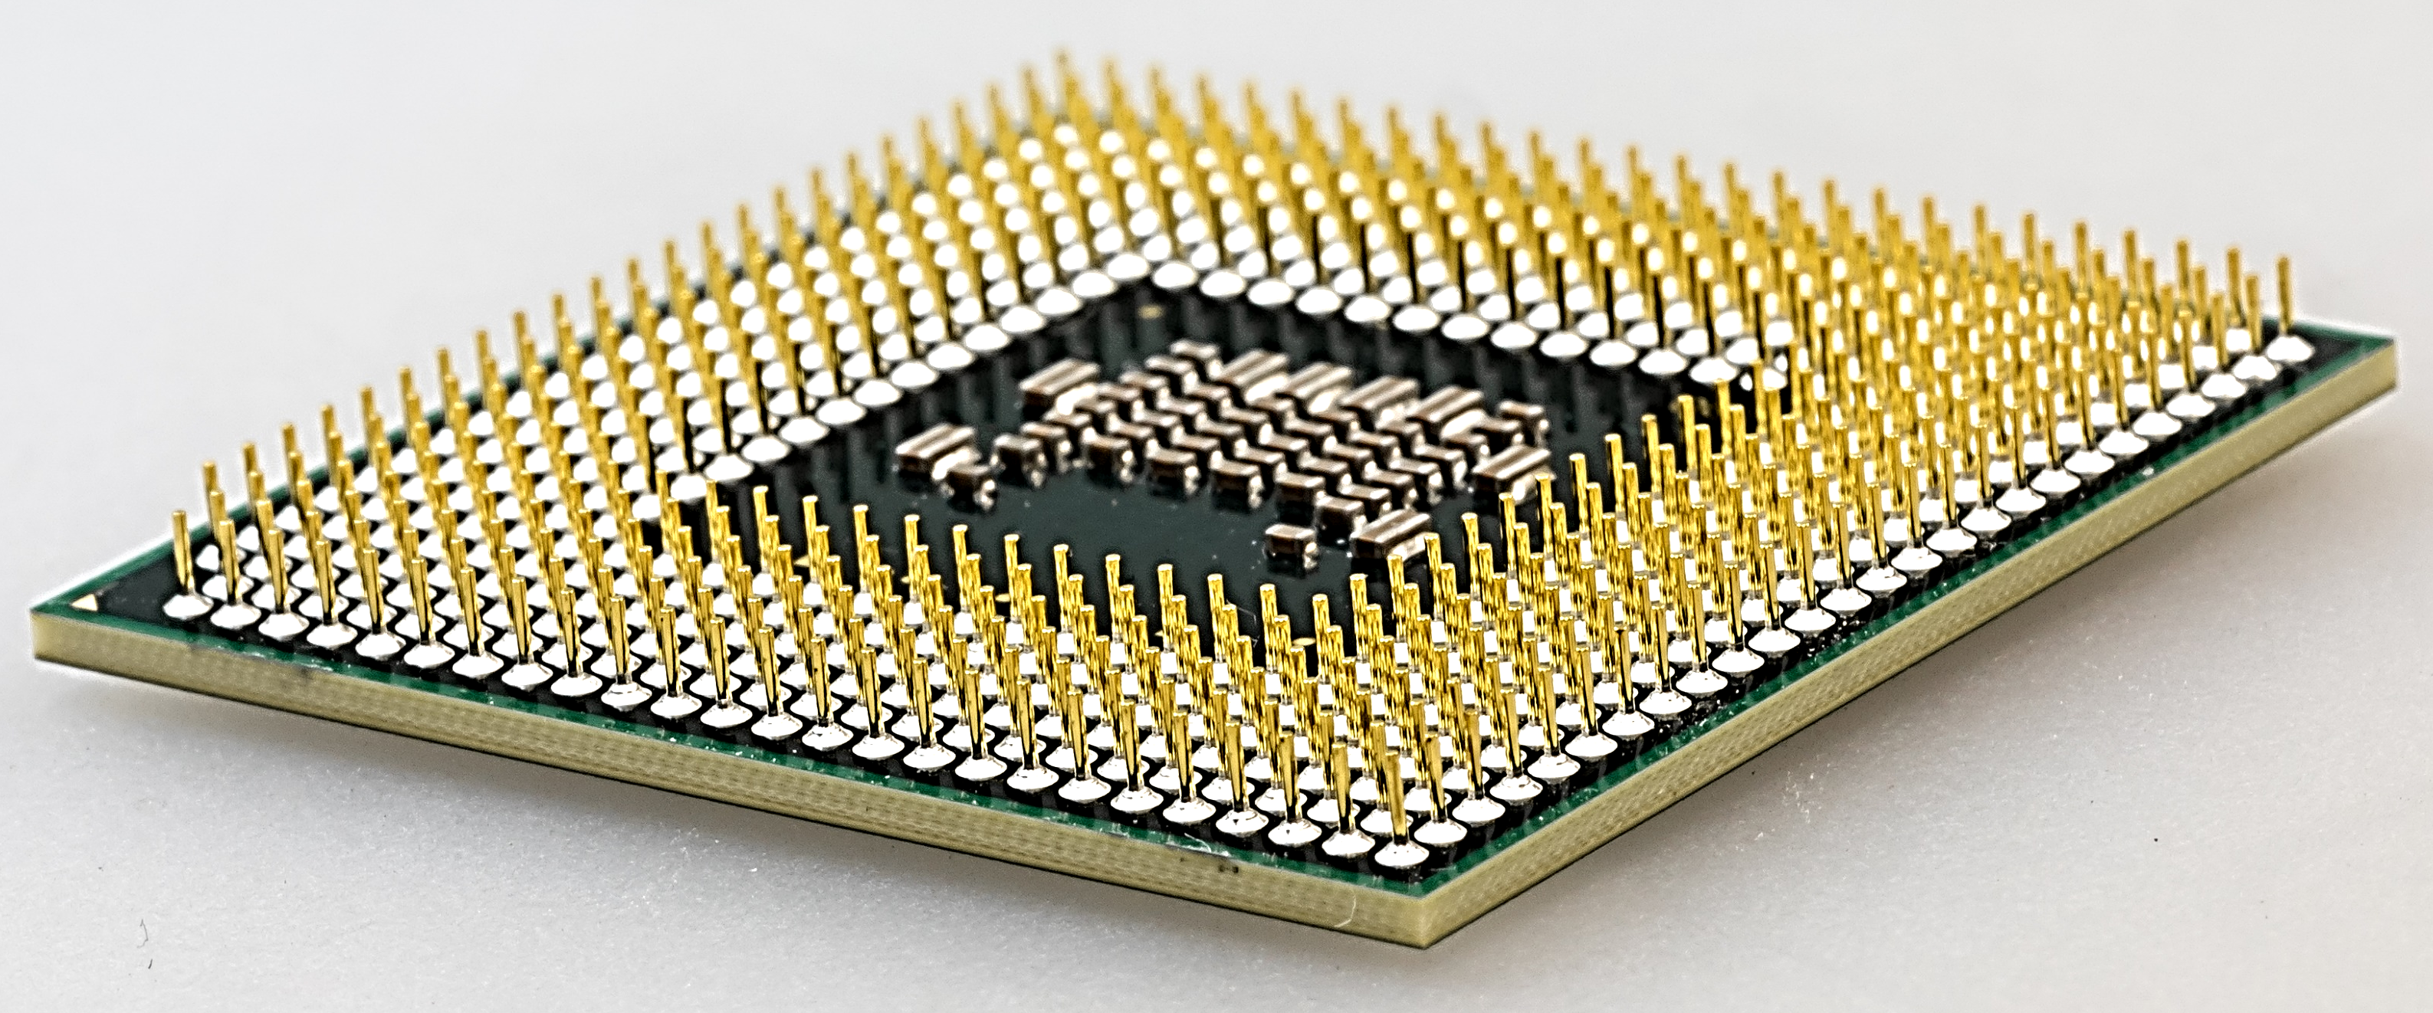

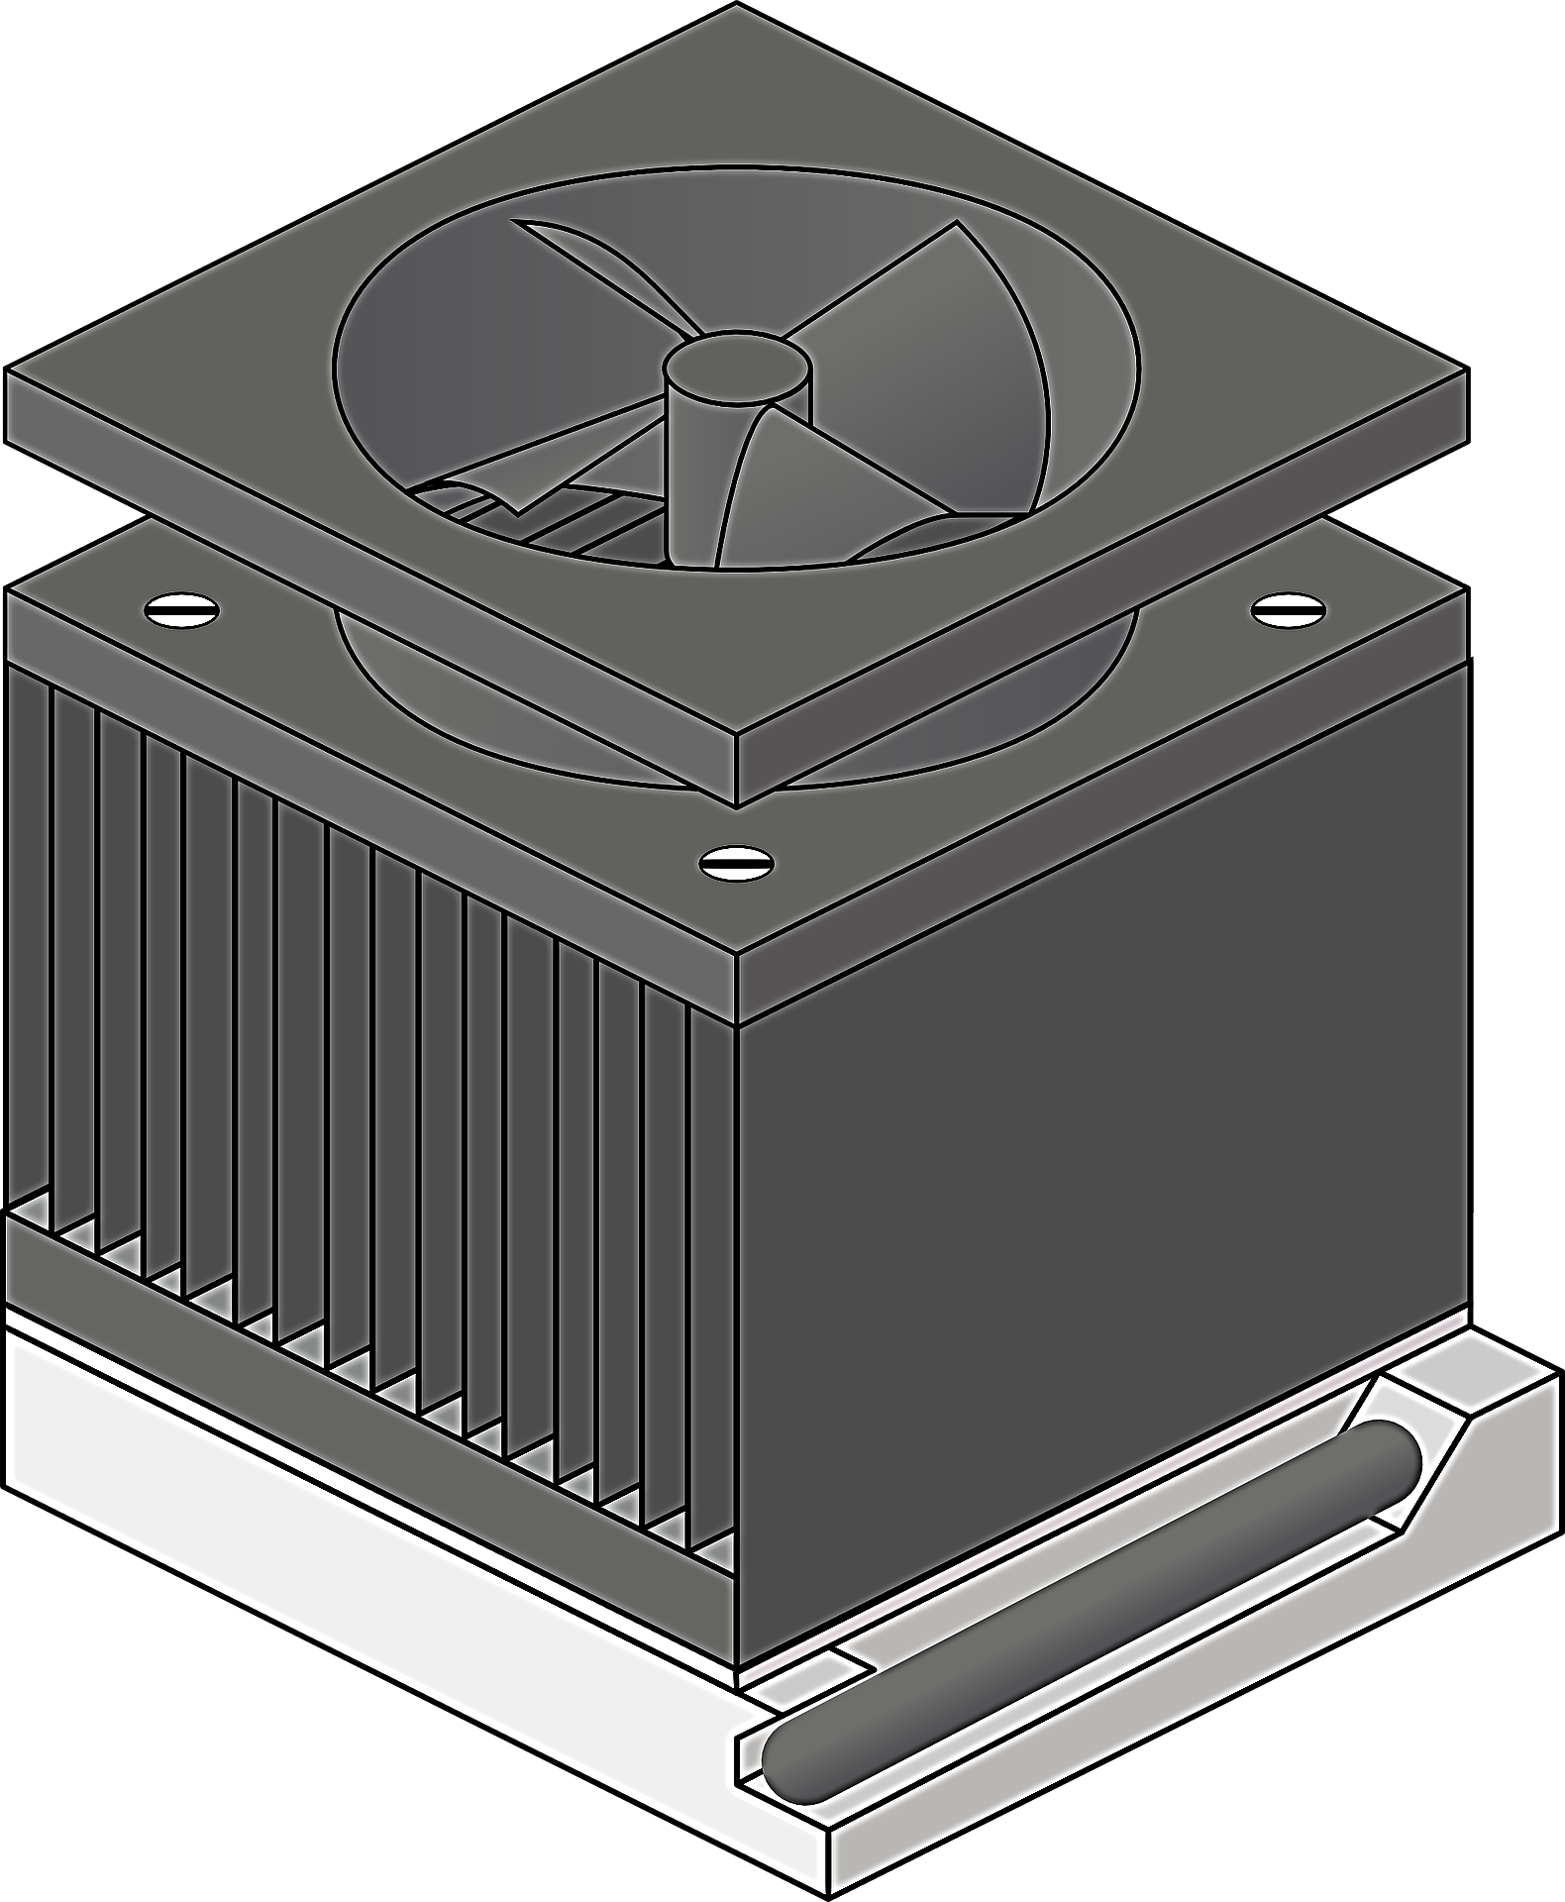
Processor speed
Processor speed measures how many operations it performs per second, measured in GHz. Higher speed means faster processing, but performance also depends on cores and design.
Multiplier
X*4

Slide 6
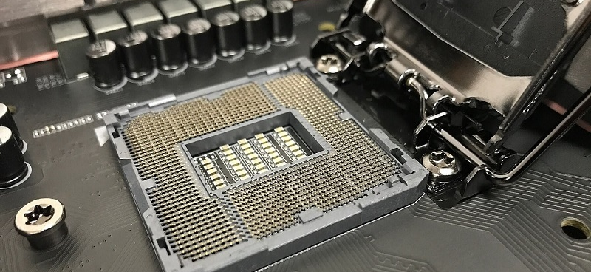

Socket and Chipset

Slide 7
Processors architecture
Processor 32 bit86
Processor 64 bit
Hybrid Processor
Memory Handling
Supports up to 4 GB of RAM
Supports more than 4 GB of RAM
Supports both 32-bit and 64-bit usage
Processing Performance
Less efficient for heavy tasks
Higher efficiency for heavy tasks
Depends on configuration, offering flexible performance
Software Compatibility
Compatible with older software
Compatible with modern software
Compatible with software across multiple systems
Processing Performance
Less secure compared to 64-bit
Provides additional security features
Offers security features based on type and configuration
Before 2000
Pentium 2001
intel
Pentium 4 intel 2005
Athlon 64
AMD 2003

Slide 8
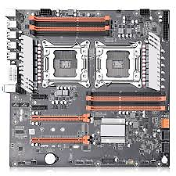
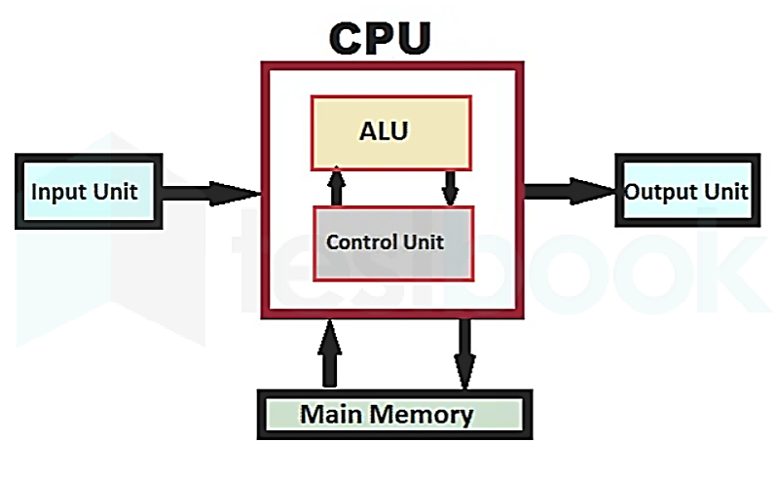
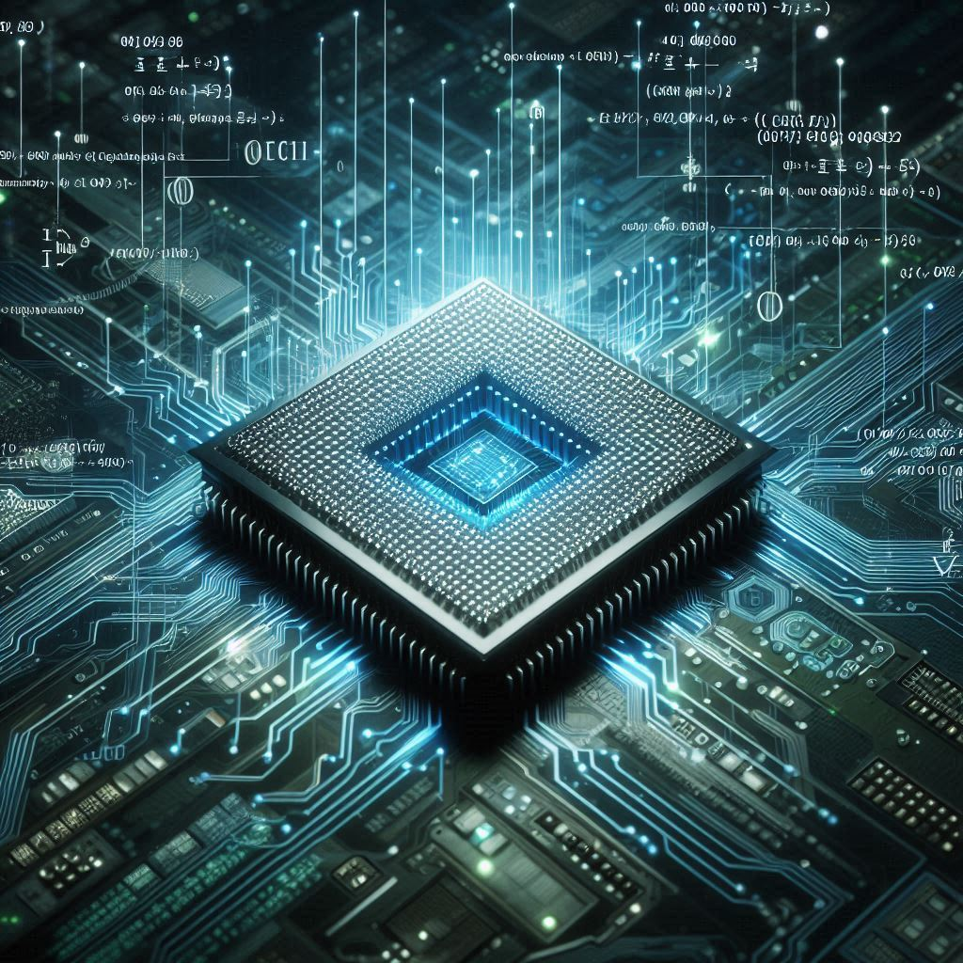
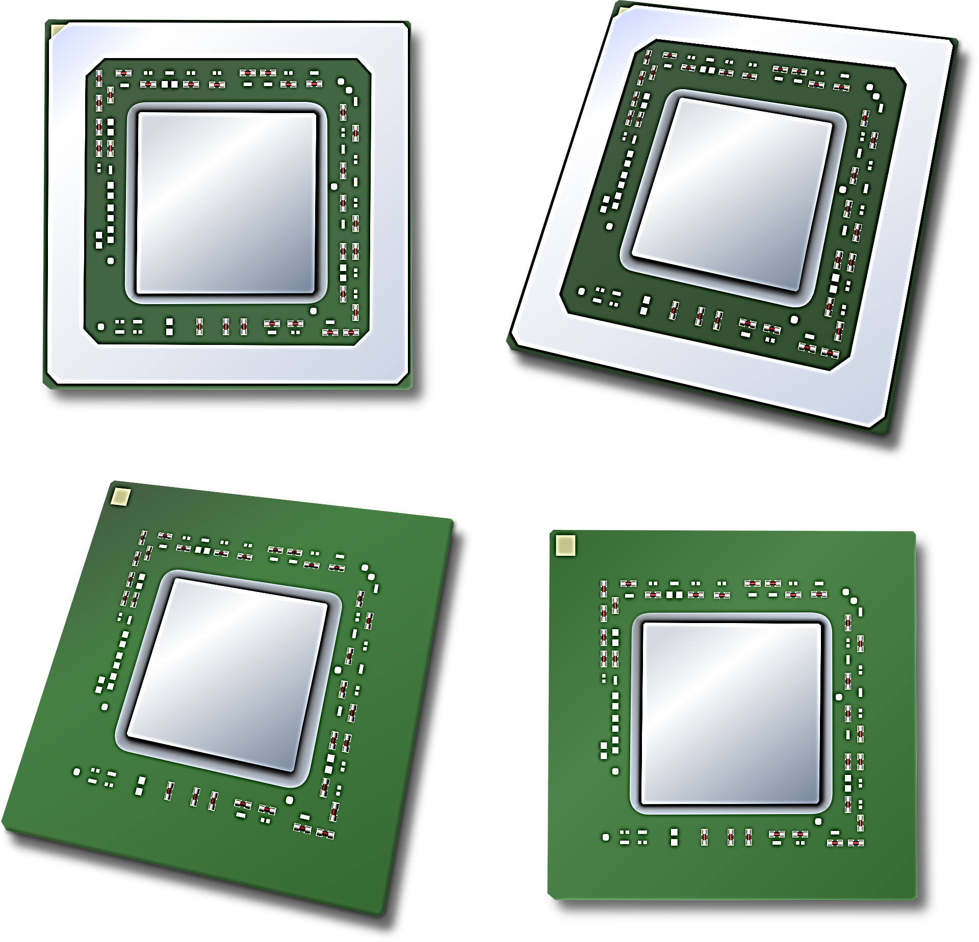
Multiprocessing Avidities
Multiprocessing
Multithreading
Multicore Processing
Dual Processing

Slide 9
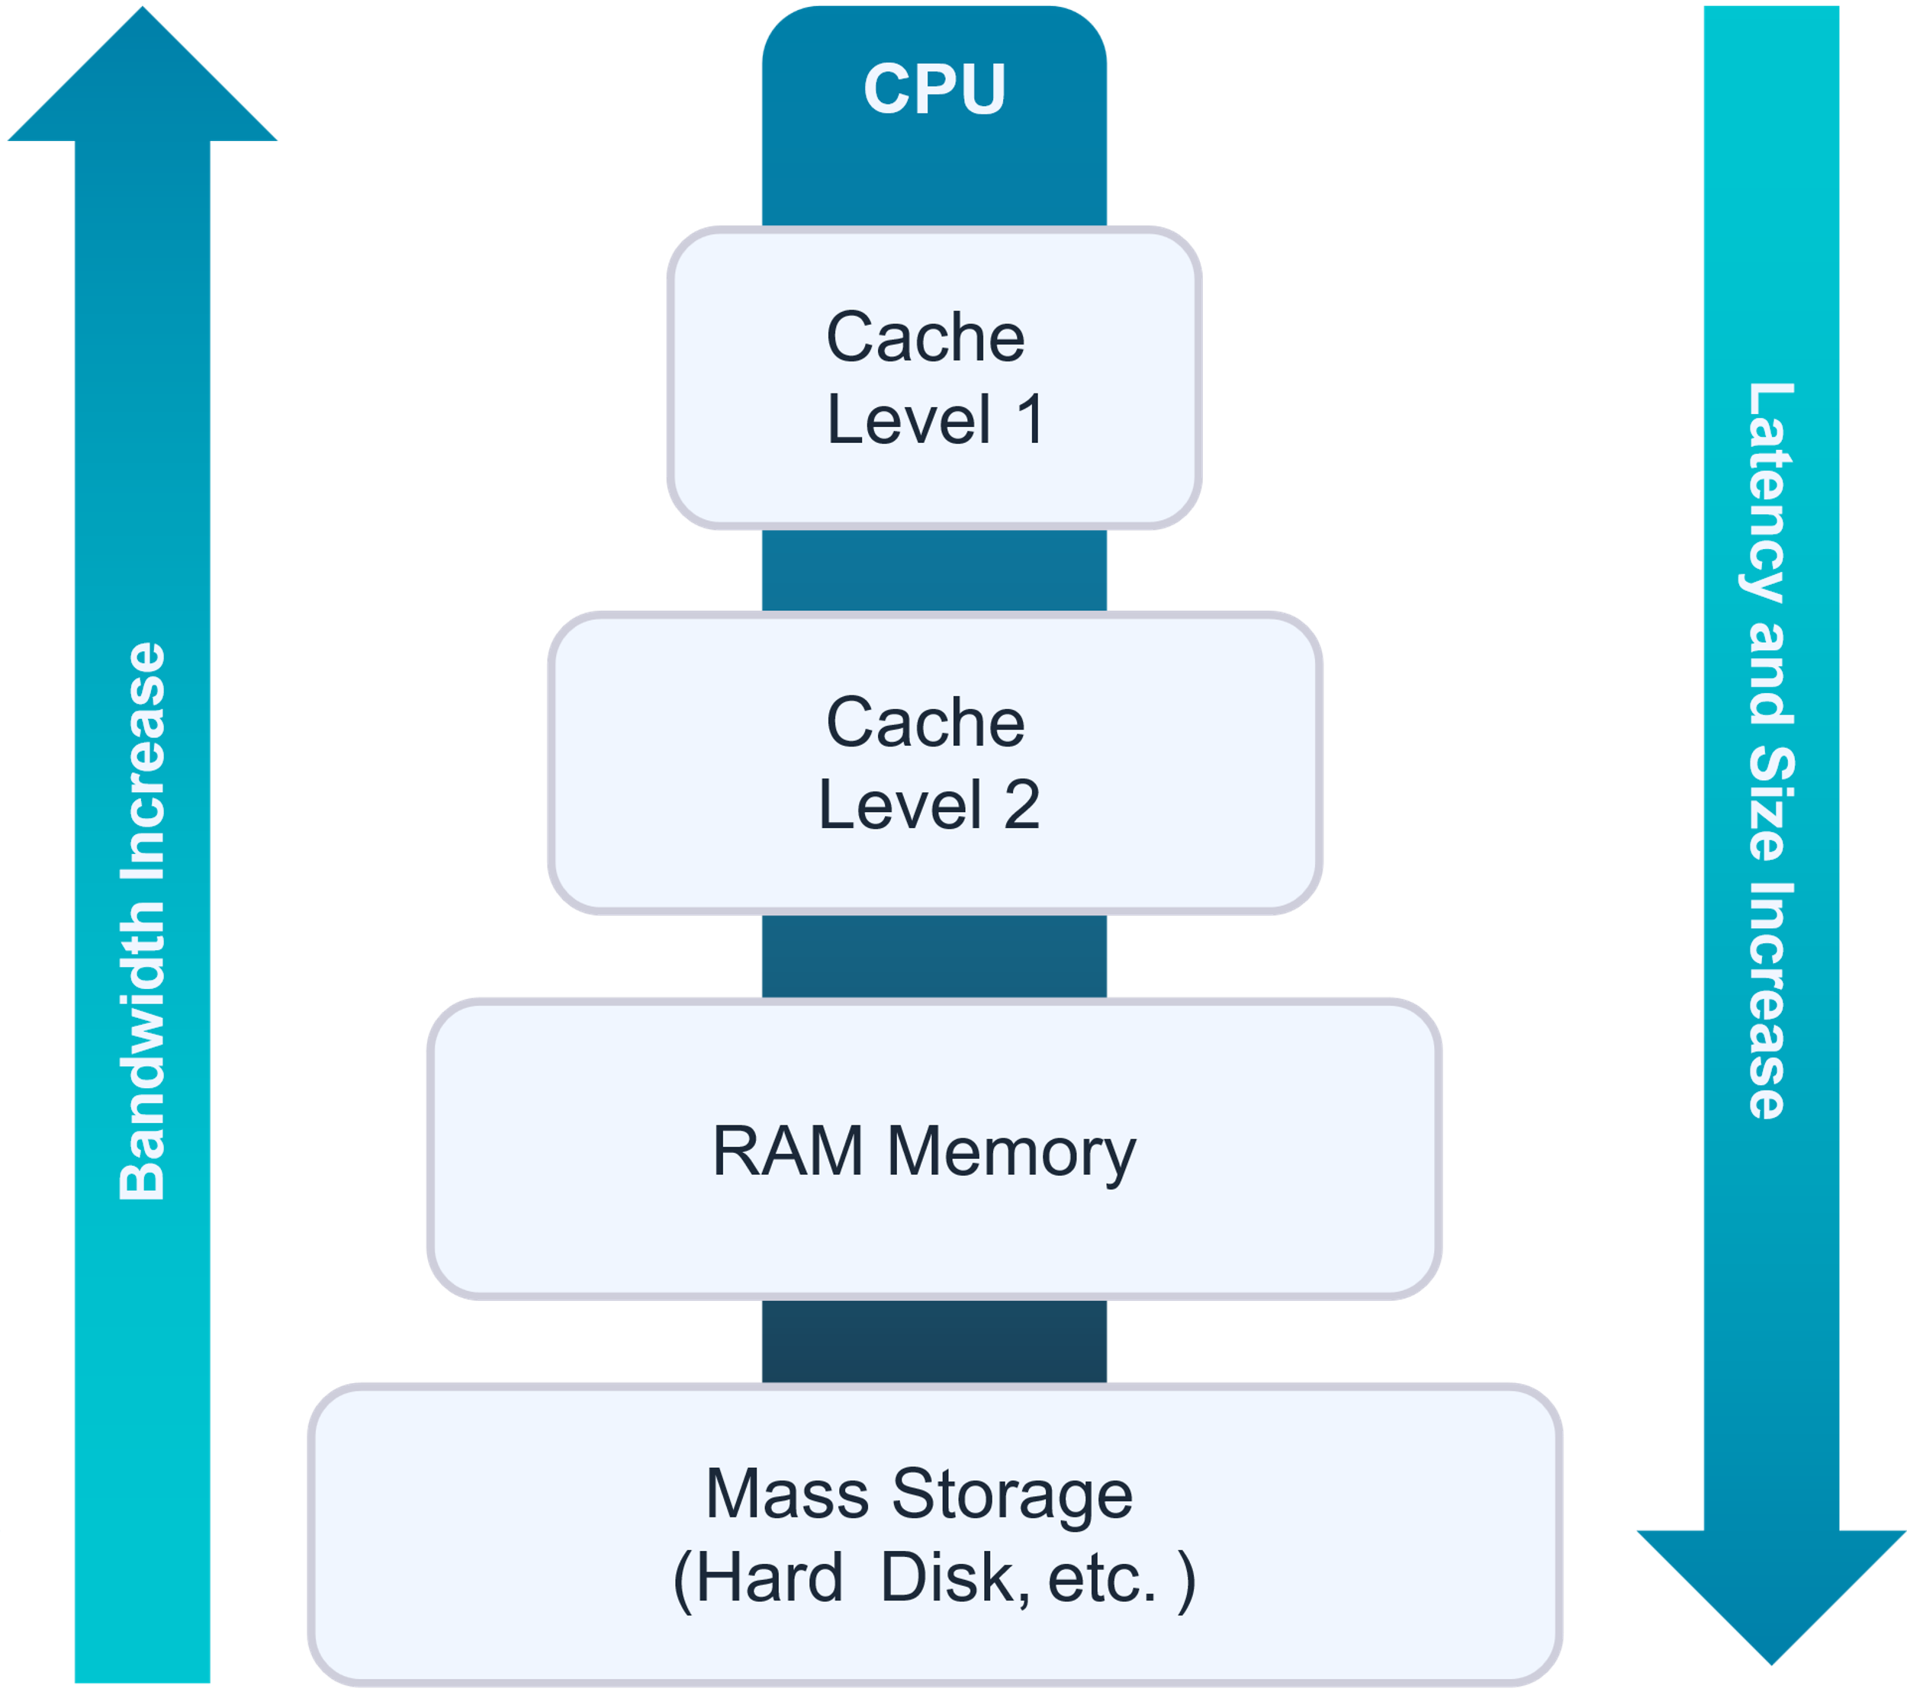
Cache memory
Cache Memory is faster than RAM and operates at speeds measured in nanoseconds. It consists of multiple levels:
L1 Cache: The fastest, integrated within the processor.
L2 Cache: Slightly slower than L1 but still fast.
L3 Cache: The slowest among the levels, but faster than RAM

Slide 10


Security
Data Execution Prevention (DEP): A security feature that prevents code from being executed in certain regions of memory that should only contain data. This helps to prevent buffer overflow attacks.

Slide 11
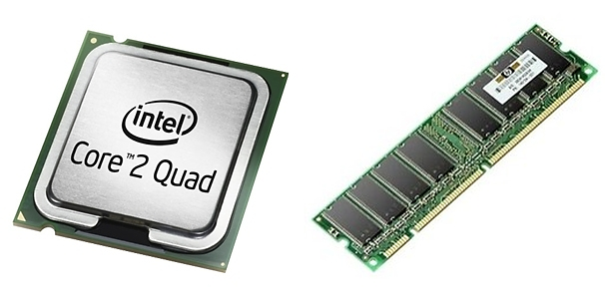
The memory Feature
DDR3, DDR4, DDR5
Memory speed
Memory channel
Amount of memory

Slide 12


Support of Virilization
Virtualization support in CPUs
enhances performance and security by allowing multiple virtual machines to run efficiently on a single processor. Key features include hardware-assisted virtualization (VT-x/AMD-V) and I/O virtualization (VT-d/AMD-Vi) for better resource management and isolation.

Slide 13
Integration Graphic
Integrating a GPU into a CPU offers good graphics performance, energy efficiency, and reduces system complexity. Examples include Intel UHD Graphics and AMD APUs.

Slide 14
Tank you

